Slide 1

MONITORING CENTER SYSTEM

Slide 2
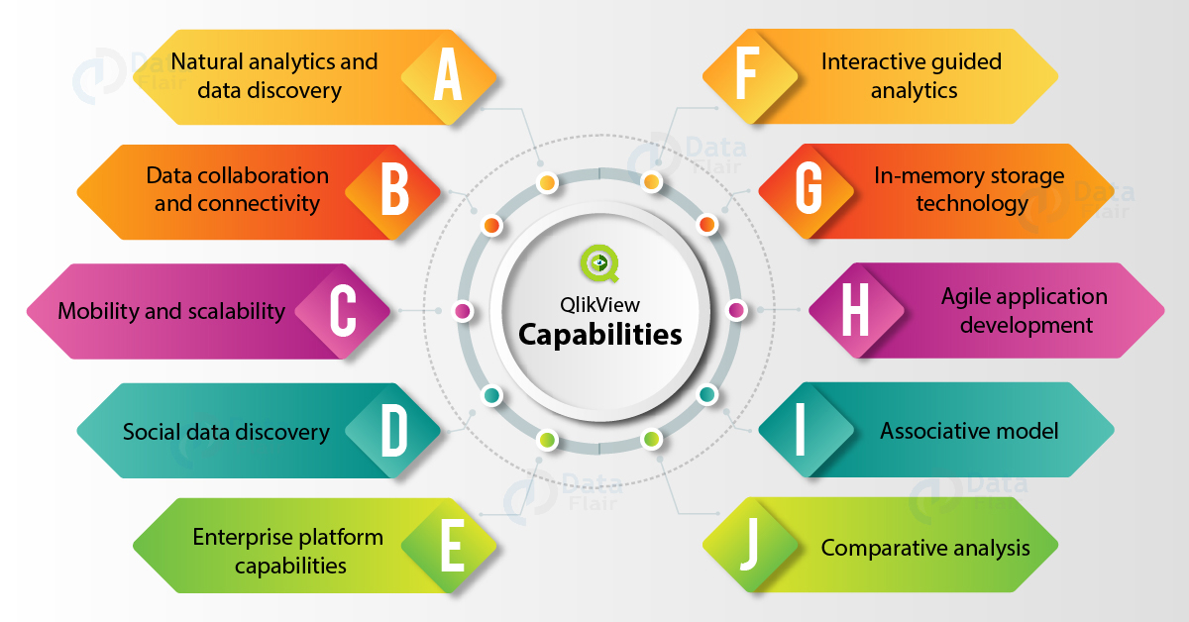

Slide 3
Summary
Thus, these were all the main capabilities and features. We hope our information helps you in understanding the tool better and making the right decision by selecting the best BI tool according to your needs.

